Slide 1
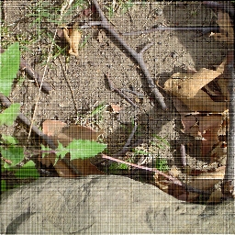
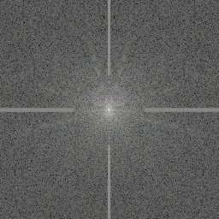

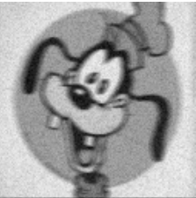
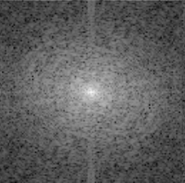


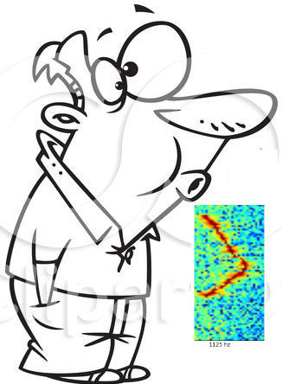

Fast Fourier Transforms
C - # 6th octave
1125 Hz
Analabha Roy
Department of Physics, The University of Burdwan
Notes:
A Fourier Transform is a linear operation that bijectively maps a series of data (that satisfies certain conditions) to another series of the same size and shape. This particular transform serves to decompose the data into the harmonic frequencies that make it up. As an example (show in pic), a musical chord can be expressed in terms of the amplitudes of its constituent frequencies (notes). Sometimes called “frequency domain representation”, and simply “spectrum”. FT's are used in many applications, like solving ODE/PDE's, selecting and/or enhancing interesting features in data etc. I'll be showing the numerics of this process. FT's are part of a general class of “integral transforms” that integrates over the entire domain the given data (or associated function) with weights for each data site in the domain. Thus, N data sites give N data sites in the transform as well.

Slide 2

1. Introduction
Intuitive explanation of Fourier Theory
Any signal (Spatially and/or temporally varying data like images, sounds etc.) can be expressed as a formal sum of sinusoids
Notes:
The phases, magnitudes and frequencies of a signal contain all the information required to replicate the signal completely.

Slide 3
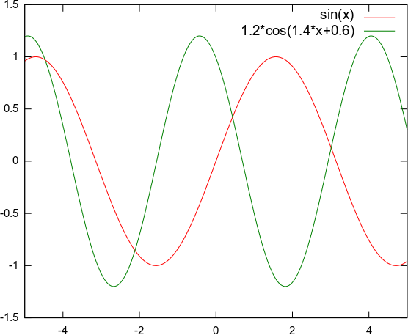
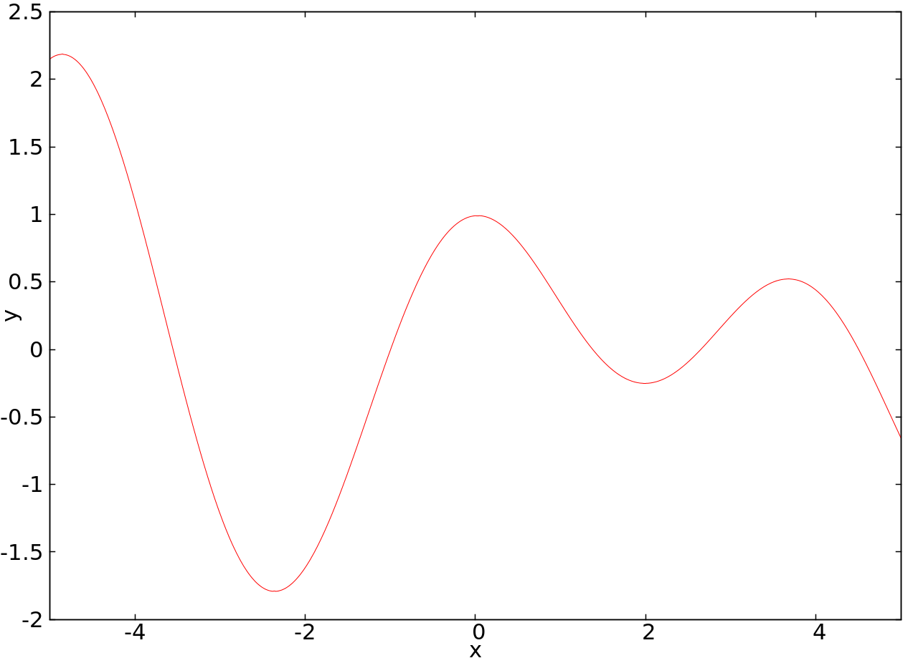
1. Introduction
Intuitive explanation of Fourier Theory
Any signal (Spatially and/or temporally varying data like images, sounds etc.) can be expressed as a sum of series of sinusoids
1 – Dimensional Example (we'll stick to 1D for the rest of this session)
Add the components
Resolve the signal
2
1
0
0.5
-2
Fourier Transform:
Plot of Amplitudes (Phases) as functions of resolved frequencies
-2
-1
0
1
2
0
2
-2
-1
0
1
Notes:
For example, this signal (in 1d now).
A Fourier transform encodes not just a single sinusoid, but a whole series of sinusoids through a range of spatial frequencies from zero (i.e. no modulation, i.e. the average brightness of the whole image) all the way up to the "nyquist frequency", i.e. the highest spatial frequency that can be encoded in the digital image, which is related to the resolution, or size of the pixels. The Fourier transform encodes all of the spatial frequencies present in an image simultaneously as follows. A signal containing only a single spatial frequency of frequency f is plotted as a single peak at point f along the spatial frequency axis, the height of that peak corresponding to the amplitude, or contrast of that sinusoidal signal.
There may also be a "DC term" corresponding to zero frequency, that represents the average intensity across the whole signal. A zero DC term would mean a signal with average intensity of zero, which would mean the sinusoid alternated between positive and negative values in the brightness image, as in our examples so far.

Slide 4
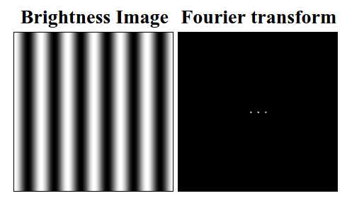
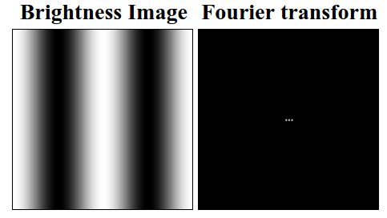
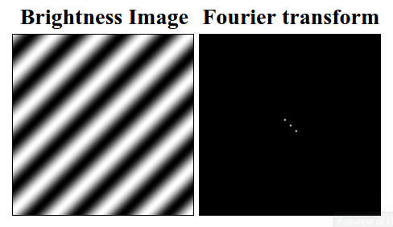
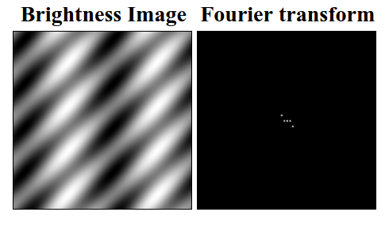
1. Introduction
Intuitive explanation of Fourier Theory
Any signal (Spatially and/or temporally varying data like images, sounds etc.) can be expressed as a sum of series of sinusoids
2 – Dimensional Examples (we'll stick to 1D for the rest of this session)
Notes:
The first image shows a sinusoidal brightness image, and its 2d Fourier transform, presented here also as a brightness image. Every pixel of the Fourier image is a spatial frequency value, the magnitude of that value is encoded by the brightness of the pixel. In this case there is a bright pixel at the very center - this is the DC term, flanked by two bright pixels either side of the center, that encode the sinusoidal pattern. The brighter the peaks in the Fourier image, the higher the contrast in the brightness image. Since there is only one Fourier component in this simple image, all other values in the Fourier image are zero, depicted as black.
2nd image, lower frequency so FT points are closer
3rd image, same frequency magnitudes, but the k vector is “tilted” (rotated by 45 degrees)
Different Fourier coefficients combine additively to produce combination patterns. For example the sinusoidal image shown below is computed as the sum of the tilted sinusoid shown above, and the vertical sinusoid of lower spatial frequency shown above that.

Slide 5
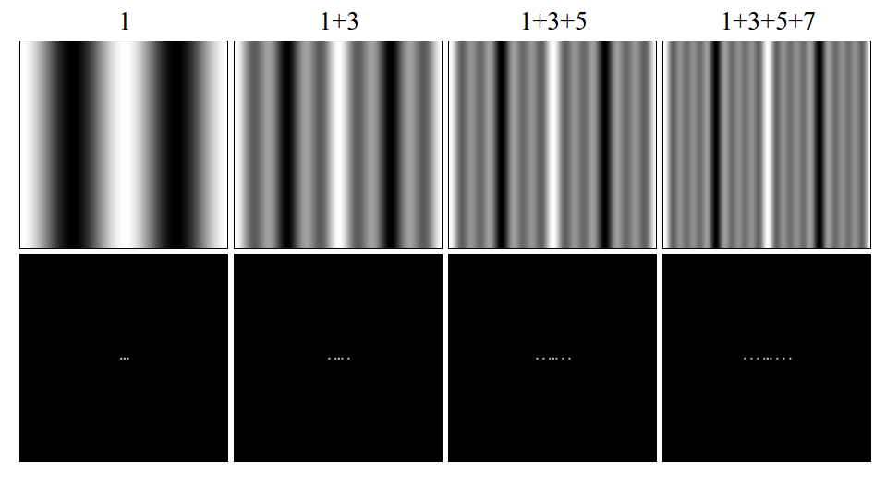
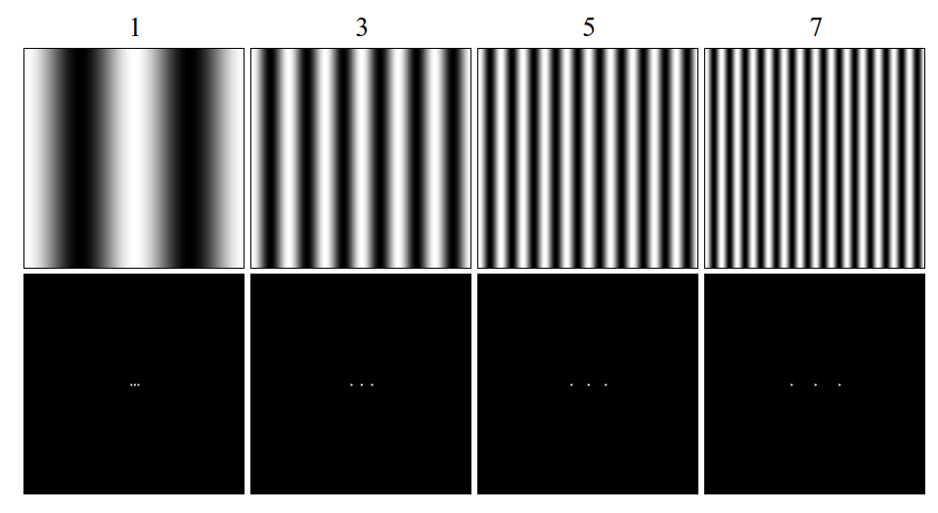
1. Introduction
Intuitive explanation of Fourier Theory
Any signal (Spatially and/or temporally varying data like images, sounds etc.) can be expressed as a sum of series of sinusoids
Higher Harmonics – If signal is “finite” (in extent) or has sharp discontinuities
Notes:
The basis set for the Fourier transform is the smooth sinusoidal function, which is optimized for expressing smooth rounded shapes. But the Fourier transform can actually represent any shape, even harsh rectilinear shapes with sharp boundaries, which are the most difficult to express in the Fourier code, because they need so many higher order terms, or higher harmonics. How these "square wave" functions are expressed as smooth sinusoids will be demonstrated by example.
First fig shows four sinusoidal brightness images of spatial frequency 1, 3, 5, and 7. The first one, of frequency 1, is the fundamental, and the others are higher harmonics on that fundamental, because they are integer multiples of the fundamental frequency. These are in fact the "odd harmonics" on the fundamental, and each one exhibits a bright vertical band through the center of the image. The Fourier transform for each of these patterns is shown below.
Next fig shows the result of progressively adding higher harmonics to the fundamental. Note how the central vertical band gets sharper and stronger with each additional higher harmonic, while the background drops down towards a uniform dark field. Note also how the higher harmonics produce peaks in the Fourier images that spread outward from the fundamental, defining a periodic pattern in frequency space.

Slide 6
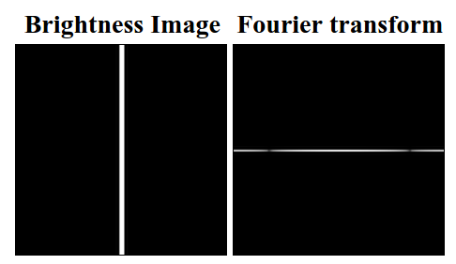
1. Introduction
Intuitive explanation of Fourier Theory
Any signal (Spatially and/or temporally varying data like images, sounds etc.) can be expressed as a sum of series of sinusoids
Higher Harmonics – If signal is “finite” (in extent) or has sharp discontinuities
Notes:
This image shows what would happen if this process were continued all the way out to the Nyquist frequency (I'll explain this term later - The highest possible frequency that can be meaningfully resolved) - it would produce a thin vertical stripe in the brightness image, with sharp boundaries, i.e. a "square wave" in brightness along the x dimension. The Fourier transform of this image exhibits an "infinite" series of harmonics or higher order terms, although these do not actually go out to infinity due to the finite resolution of the original image. This is how the Fourier transform encodes sharp square-wave type features as the sum of a series of smooth sinusoids.

Slide 7
2. Theoretical Section:
Formal Definition of Fourier Transform (FT):
Suppose is absolutely integrable in , then the FT is
Moreover, if the function is square integrable, then the inverse FT (IFT) is

Slide 8
2. Theoretical Section:
Formal Definition of Fourier Transform (FT):
Suppose is absolutely integrable in , then the FT is
So if
1
0.5
0
2
-2
-1
0
1

Slide 9

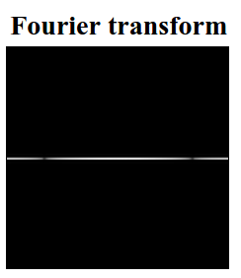
2. Theoretical Section:
Formal Definition of Fourier Transform (FT):
Suppose is absolutely integrable in , then the FT is
So if

Slide 10
2. Theoretical Section:
Important Properties of Fourier Transform (FT):
  1. Derivative to Coefficient:
  2. Translation Property:
  3. Convolution Property:
  where
  4. Parseval's theorem:
Notes:
Equation [2] should make some intuitive sense.
If the original function g(t) is shifted in time by a constant amount,
it should have the same magnitude of the spectrum, G(f).
That is, a time delay doesn't cause the frequency content of G(f) to
change at all. This should make sense. Since the complex
exponential always has a magnitude of 1, we see the time delay
alters the phase of G(f) but not its magnitude. In eq [3],
A convolution is a sliding, weighted-sum of function f1(\tau), where
the weighting function is f2(-\tau).

Slide 11
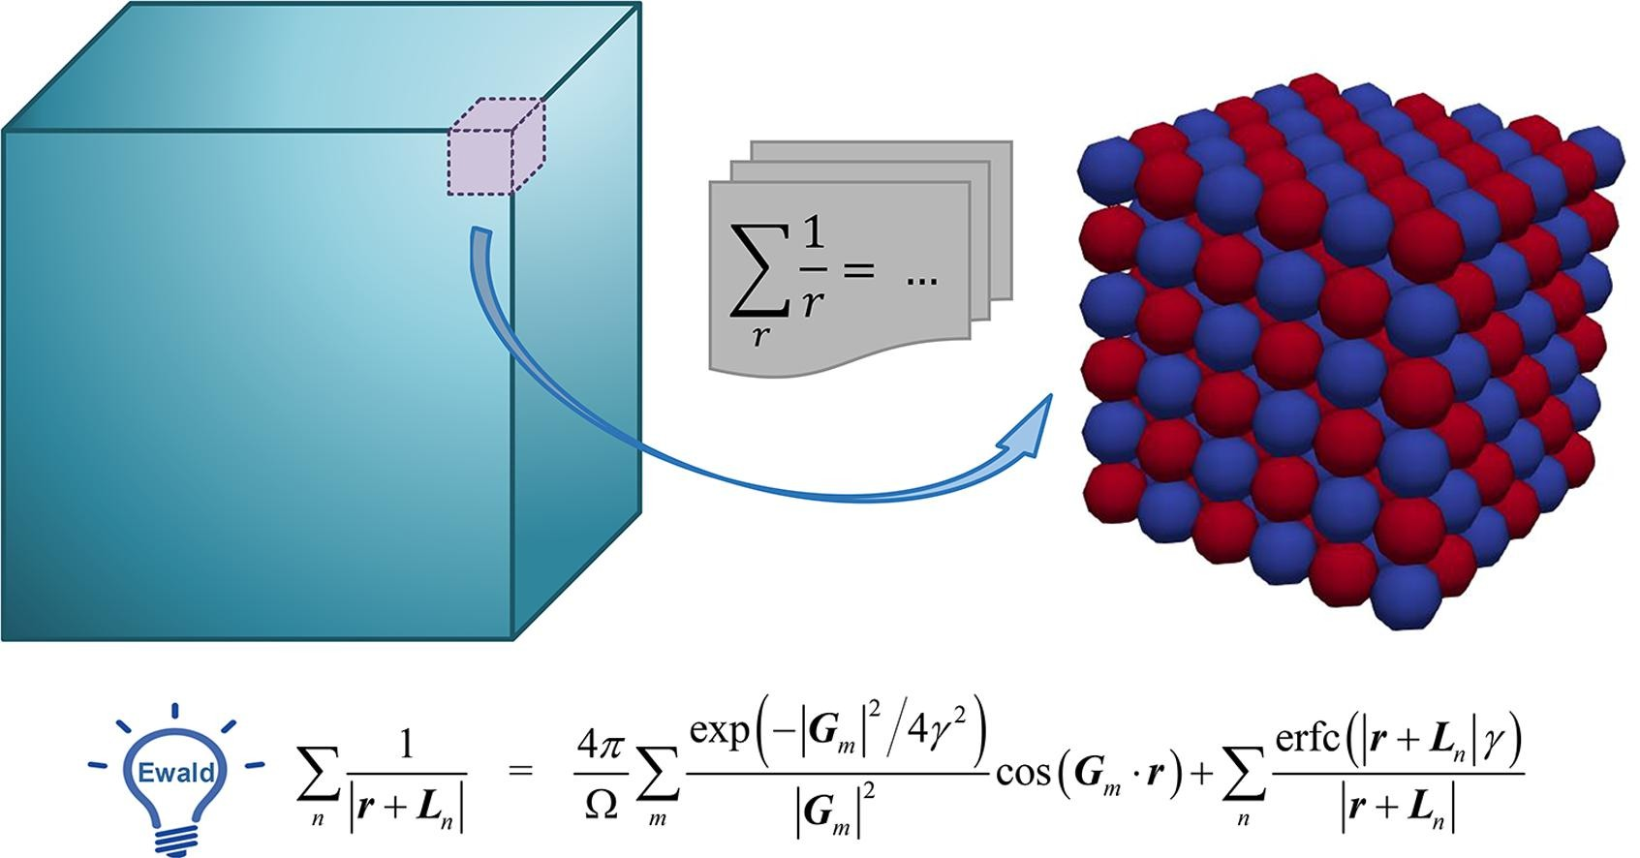


2. Theoretical Section:
Important Properties of Fourier Transform (FT):
  3. Convolution Property:
  where
  This property is especially powerful numerically, especially if
    Physicists will immediately recognize Coulomb-like electrostatic potential energy
    Need this to get lattice energies in Solid State Physics, as well as interactions in Molecular Dynamics (MD)
    However, the Coulomb Integral converges slowly, leading to numerical inefficiency
    However, the FFTs converge much faster, and even better if is known analytically
    In physics, this is called the Ewald summation
    In computational (bio)chemistry, this is called the “Particle-Mesh Ewald” method
    Implemented in MD software such as GROMACS, NAMD, GAMESS CP2K etc. to compute long-range non-bonded interactions (Coulomb, Van-der-waals etc.)
Notes:
Equation [2] should make some intuitive sense.
If the original function g(t) is shifted in time by a constant amount,
it should have the same magnitude of the spectrum, G(f).
That is, a time delay doesn't cause the frequency content of G(f) to
change at all. This should make sense. Since the complex
exponential always has a magnitude of 1, we see the time delay
alters the phase of G(f) but not its magnitude. In eq [3],
A convolution is a sliding, weighted-sum of function f1(\tau), where
the weighting function is f2(-\tau).

Slide 12
2. Theoretical Section:
Important Properties of Fourier Transform (FT):
If ...
Then ...
is real
is imaginary
is even | i.e. so is
is odd | i.e. so is
is real and even | is real and even
is real and odd | is imaginary and odd
is imaginary and even | is imaginary and even
is imaginary and odd | is real and odd

Slide 13
3. The Discreet Fourier Transform (DFT)
Given the function, sample it at discrete points and estimate the FT
The value of the function is recorded at regular time intervals and assembled into a vector
Given a discreet vector of data, estimate the FT
The data given might not correspond to a function sampled at regular intervals
So regularize it (estimate the function locally by interpolation and sample it as above)
Sampling Rate
DFT

Slide 14
3. The Discreet Fourier Transform (DFT)
DFT

Slide 15
3. The Discreet Fourier Transform (DFT)
Periodic in m with period N i.e
Important Properties of DFT:
  1. Convolution Property
  where extended by periodic summation
  2. Parseval's theorem:
Notes:
Extended by periodic summation???

Slide 16
3. The Discreet Fourier Transform (DFT)
Inverse DFT
Sampling Rate
Sampling Interval
DFT
DFT
There is a critical frequency associated with the sampling rate
Nyquist frequency (Nyquist rate)

Slide 17
3. The Discreet Fourier Transform (DFT)
Sampling Rate
Sampling Interval
DFT
DFT
There is a critical frequency associated with the sampling rate
Nyquist frequency (Nyquist rate)
Discretize and build the vector

Slide 18
3. The Discreet Fourier Transform (DFT)
Sampling Rate
Sampling Interval
DFT
DFT
There is a critical frequency associated with the sampling rate
Nyquist frequency (Nyquist rate)
Any frequency in your data that is at Nyquist rate does not get detected !!
Worse, any frequency that is more than the Nyquist rate gives you a false
frequency, a phenomenon called aliasing

Slide 19
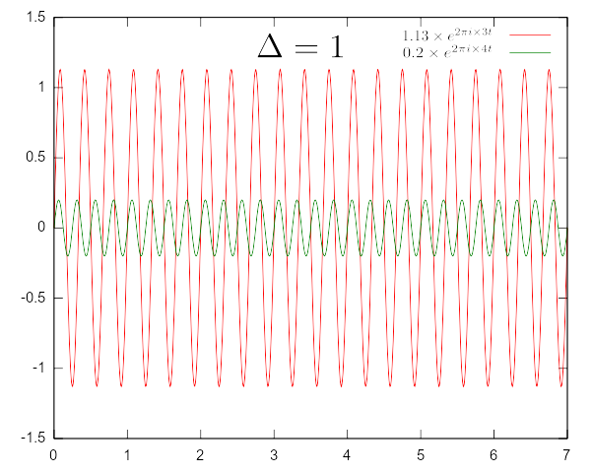
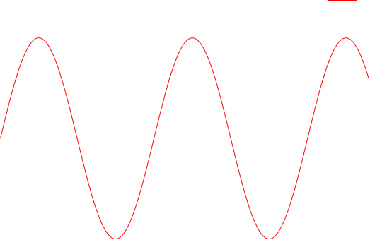
3. The Discreet Fourier Transform (DFT)
Sampling Rate
There is a critical frequency associated with the sampling rate
Sampling Interval
Nyquist frequency (Nyquist rate)
Any frequency in your data that is at Nyquist rate does not get detected !!
Worse, any frequency that is more than the Nyquist rate gives you a false
frequency, a phenomenon called aliasing
The total signal is being sampled at intervals
If the two frequencies differ by a multiple of the sampling rate,
Then they give the same samples!
Sampling rate is just length of the interval
Any frequency outside this interval gets aliased into it

Slide 20
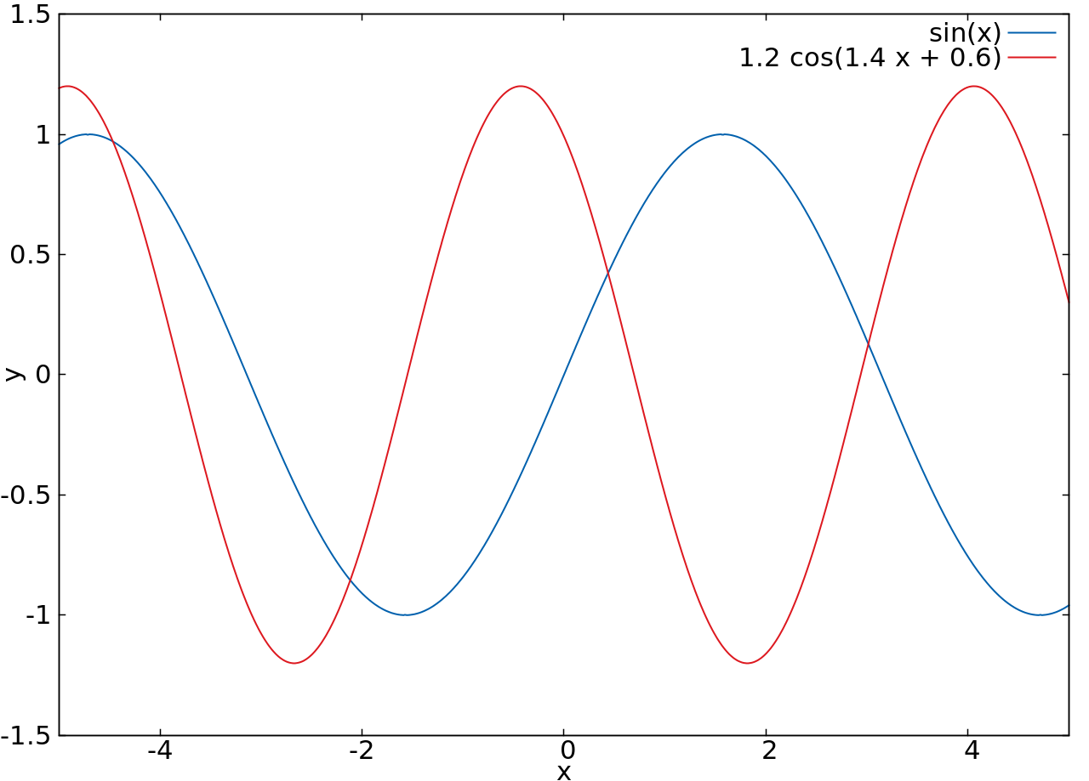
3. The Discreet Fourier Transform (DFT)
How to handle aliasing?
Know the natural bandwidth of the signal
If you already know something about what frequencies are there
Make sure that your Nyquist rate is faster than the largest expected frequency
Add the components
Resolve the signal

Slide 21
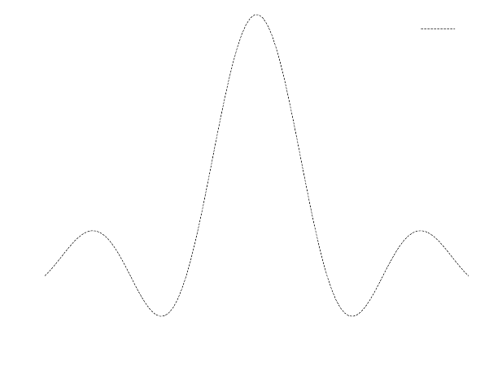
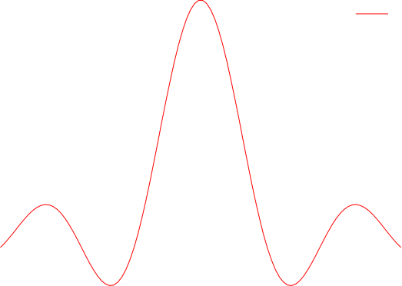
3. The Discreet Fourier Transform (DFT)
How to handle aliasing?
Know the natural bandwidth of the signal
If you already know something about what frequencies are there
Make sure that your Nyquist rate is faster than the largest expected frequency
Choose a Nyquist rate, and sample the data accordingly
If the FFT is too large at the Nyquist edges, then you're aliasing high frequencies
Increase the Nyquist rate and re-sample
Keep doing this until the FFT at the Nyquist edges is small enough to ignore.
Brightness Image Fourier Transform
Infinitely extended signals with (quasi) periodic behavior are not expected to have too many frequencies (here, only 2)
Finite signals, will have many many frequencies (here, a full continuum) - larger frequencies have smaller amplitudes
Choose a sample rate. Sample. Take FFT and re - sample until aliasing falls off

Slide 22
3. The Discreet Fourier Transform (DFT)
Thus, DFT is basically just a Linear Algebra problem!
The numpy and scipy modules already have routines for matrices.
So, are we done? Not quite.
Notes:
So, are we done? Not quite. This has order N^2 operations. Very slow for large N. What if there was an algorithm that could cut down the operations to N logN? That should be much faster than N^2 for large N. That algorithm is the FFT (Fast Fourier Transform), and is coming next.

Slide 23
4. The Fast Fourier Transform (FFT)
Sampling Rate
DFT
FFT
Is there a faster way than to do this brute force matrix-vector operation?
Yes, there is! It's called the FFT algorithm.

Slide 24
4. The Fast Fourier Transform (FFT)
As a special case, consider N=4
16 multiplications and 12 additions!

Slide 25
4. The Fast Fourier Transform (FFT)
As a special case, consider N=4
2 multiplications and 8 additions!
Much faster this way!!!

Slide 26
4. The Fast Fourier Transform (FFT)
As a special case, consider N=4
2 multiplications and 8 additions!
Much faster this way!!!
This observation may reduce the computational effort from into
Much, much faster! Because

Slide 27
4. The Fast Fourier Transform (FFT)
The U matrix above consists only of roots of 1 i.e. 1, -1 &
Thus, all we need to do is group those terms in f that multiply with respectively
Add (or subtract) them as need be, then multiply them with and add/subtract the results

Slide 28
4. The Fast Fourier Transform (FFT)
The U matrix above consists only of 1s and roots of -1 i.e.
Thus, all we need to do is group those terms in f that multiply with respectively
1. Separate the odd and even indices in the sum

Slide 29
4. The Fast Fourier Transform (FFT)
The U matrix above consists only of 1s and roots of -1 i.e.
Thus, all we need to do is group those terms in f that multiply with respectively
2. Rearrange terms in the exponent so N changes to N/2 and a root of -1 comes out

Slide 30
4. The Fast Fourier Transform (FFT)
The U matrix above consists only of 1s and roots of -1 i.e.
Thus, all we need to do is group those terms in f that multiply with respectively
Two smaller DFT's: Decimation in Time
Danielson Lanczos lemma (1942!)
Based on earlier works by Gauss (1805!!)
3. Split the FFT to a combination of two smaller FFT's. This’ll work so long as N is a power of 2

Slide 31
4. The Fast Fourier Transform (FFT)
ee
e
eee
eeee … e
eeo
eeee … o
eee … oe
eo
eoe
eee … oo
eoo
eee … oee
eee … oeo
BIT REVERSED ORDER OF THE ORIGINAL INDICES!!! The famous Cooley-Tukey Algorithm
oe
oee
o
oeo
oo
ooe
ooo
ooo … o
4. Repeat recursively until you wind up with only vectors of length 1by rearranging in bit reversed order of index

Slide 32
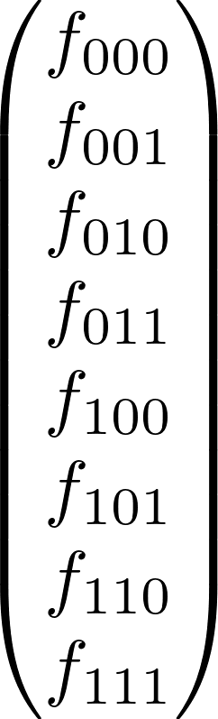
4. The Fast Fourier Transform (FFT)
ee
eee
= 000 = eee
e
eeo
= 100 = oee
eo
eoe
= 010 or eoe
eoo
= 110 = ooe
BIT REVERSED ORDER OF THE ORIGINAL INDICES!!! The famous Cooley-Tukey Algorithm
oe
oee
= 001 = eeo
o
oeo
= 101 = oeo
oo
ooe
= 011 = eoo
ooo
= 111 = ooo
It works because the successive subdivisions into even & odd are tests of successive low-order (least significant) bits of the original index.

Slide 33
4. The Fast Fourier Transform (FFT)
Danielson-lanczos lemma (recursive)
What have we done to obtain FFT analytically?
Separate the odd and even indices in the sum
Rearrange terms in the exponent so N changes to N/2 and a root of -1 comes out
Split the FFT to a combo of two smaller FFT's (Danielson – Lanczos lemma)
Repeat recursively until you wind up with only vectors of length 1 by rearranging in bit reversed order of index
How should FFT be done numerically ? The Cooley-Tukey Algorithm
Rearrange the vector in bit reversed order of index
Apply the Danielson - Lanzcos lemma to get the previous combination
Repeat this times until full FFT vector is obtained. Only multiplications!

Slide 34
4. The Fast Fourier Transform (FFT)
Danielson-lanczos lemma (recursive)
FFT Algorithm in pseudocode (without the bit reversal):
Radix-2 decimation in time (DIT) form of Cooley-Tukey algorithm (1965)
Replace the input with the output (in-place)
algorithm iterative-fft is
input: Array a of n complex values where n is a power of 2.
output: Array A the DFT of a.
bit-reverse-copy(a, A)
n ← a.length
for s = 1 to log(n) do
m ← 2s
ωm ← exp(−2πi/m)
for k = 0 to n-1 by m do
ω ← 1
for j = 0 to m/2 – 1 do
t ← ω A[k + j + m/2]
u ← A[k + j]
A[k + j] ← u + t
A[k + j + m/2] ← u – t
ω ← ω ωm
return A

Slide 35

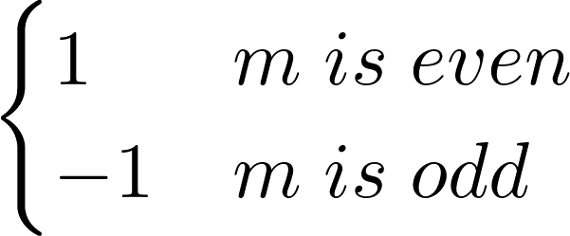
4. The Fast Fourier Transform (FFT)
Cooley-Tukey Algorithms
1. Separate the odd and even indices in the sum (Decimation in Time)
2. Separate the first and second half (Decimation in Frequency)

Slide 36

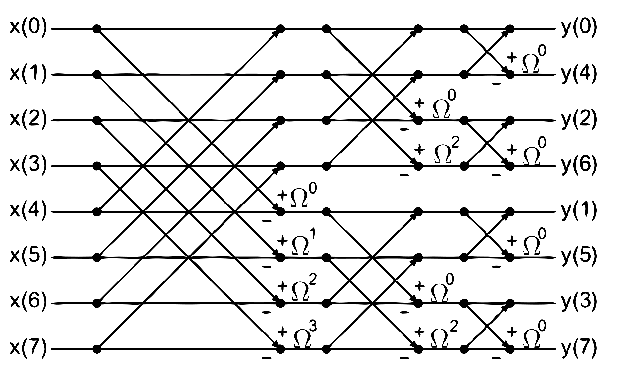
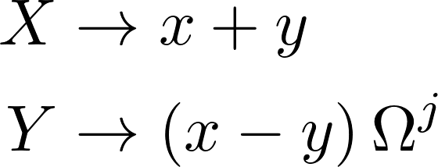
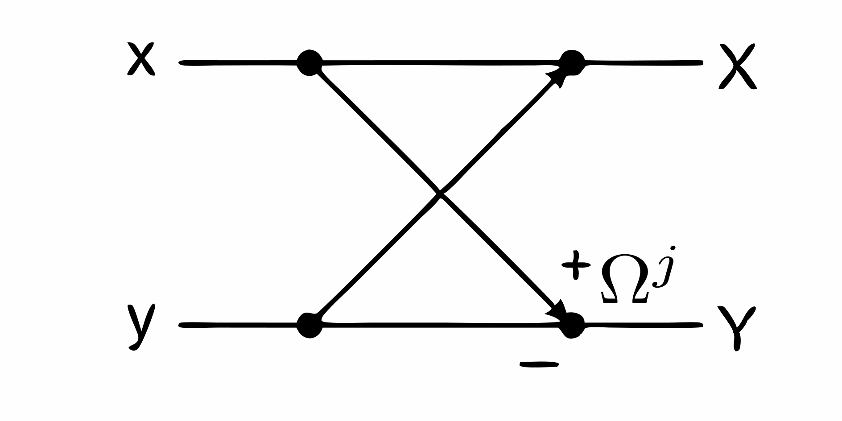
4. The Fast Fourier Transform (FFT)
Decimation in Frequency
Now, split the into odd-and-even (so, “Decimation in Frequency”)
also bit-reversed

Slide 37
4. The Fast Fourier Transform (FFT)
Decimation in Frequency
also bit-reversed
Cooley-Tukey Algorithm
bit-reversed and updated in-place (original data lost)
Stockham Algorithm
without bit-reversal updated in separate array

Slide 38
4. The Fast Fourier Transform (FFT)
The Radix of an FFT algorithm:
Radix-2 algorithm
Decimation in Frequency: Cooley-Tukey or Stockham
The number of data points to which the DFT is finally reduced in the FFT decomposition is called the radix.

Slide 39
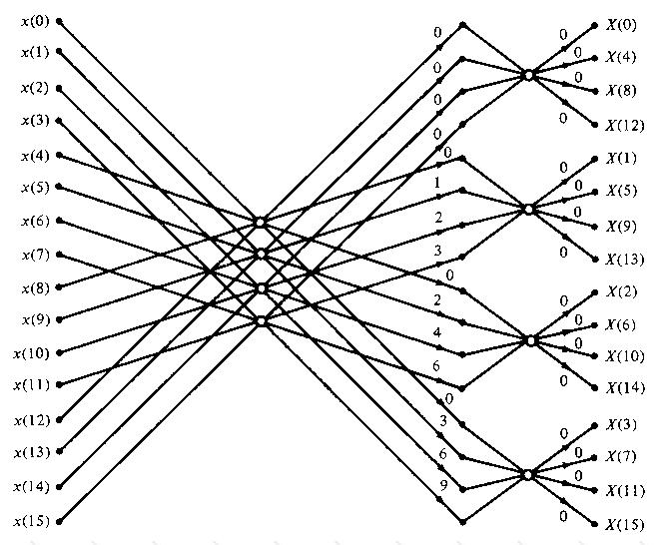
4. The Fast Fourier Transform (FFT)
The Radix of an FFT algorithm:
Radix-4 algorithm
Decimation in Frequency
The number of data points to which the DFT is finally reduced in the FFT decomposition is called the radix.

Slide 40




4. The Fast Fourier Transform (FFT)
The Radix of an FFT algorithm:
Radix-2, , # recs
Radix-4, , # recs
Higher radix means fewer recursions and more calculations per recursion
These can sometimes be faster in modern CPUs with SIMD instruction sets like Intel/AMD AVX-512 and later
SIMD CPUs have hardware that allow simultaneous floating point ops over 4+ contiguous elements in memory
FFT backends like PocketFFT (NumPy), FFTPACK (SciPy) & FFTW-3 (PyFFTW) automagically do this

Slide 41
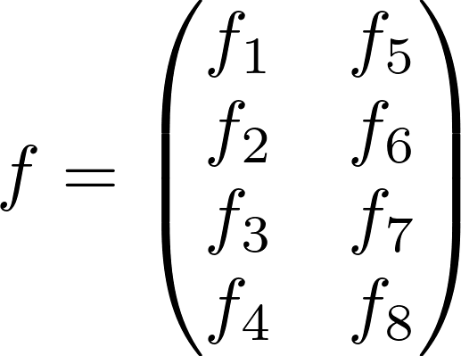

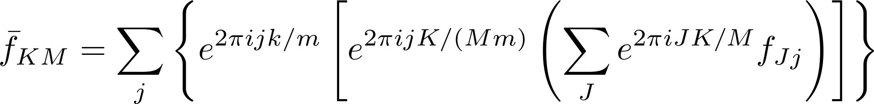
4. The Fast Fourier Transform (FFT)
Software FFT parallelization: Multithreaded support in FFTW (PyFFTW)
Factorizable: 8 = 4 X 2
Smaller DFT independent of j
Can be done in separate procs
Not always the best way

Slide 42
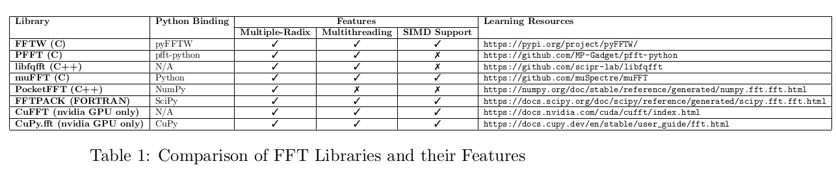
4. The Fast Fourier Transform (FFT)

Slide 43
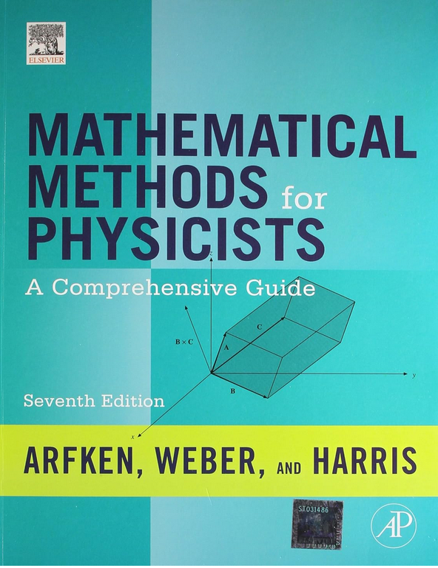
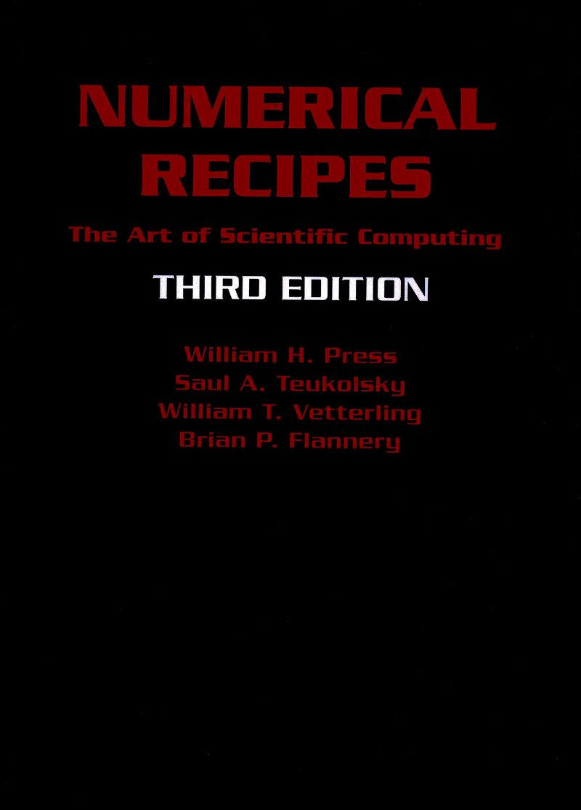
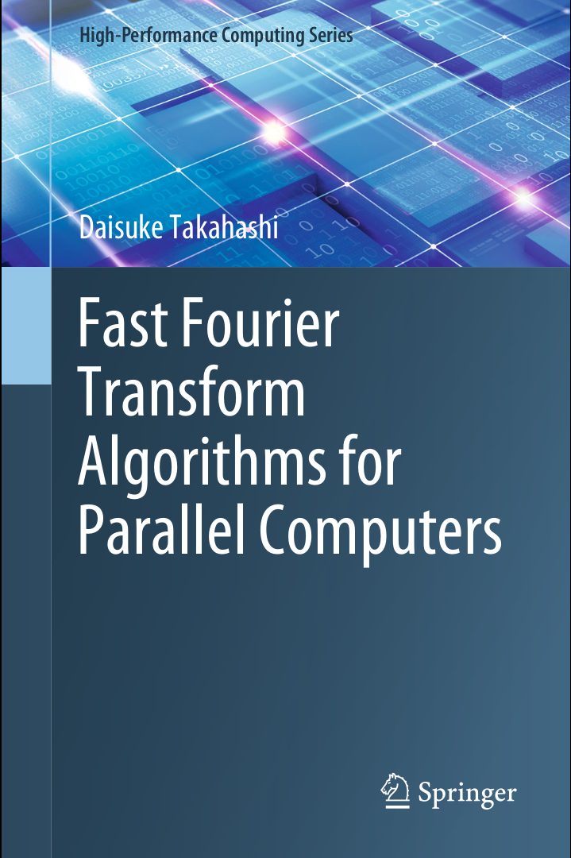

References:
ISBN: 978-9381269558
https://numerical.recipes/
ISBN: 978-9811399640
https://numpy.org/doc/stable/reference/routines.fft.html

Slide 44
5. Exercises
1a. FFT in Python:
Choose a sampling rate (say, 1000)
Evaluate the corresponding sample interval
In Python, build a 'time vector' of desired interval size in steps of the sample interval
In Python, generate data of signal as a function of time where the signal is:
  A sine wave of frequency 100
  A superposition of sine waves of different amplitudes (say, 1 and 0.3) and different
  frequencies (say 100 and 70 respectively)
For both sets of data, evaluate the FFT
Pad the signal data to a size of the nearest power of 2 to the original size:
The ‘numpy.fft.fft’ routine has a kwarg of ‘n=padded_size’ for this
To get the padded size, use 'padded_size = 2^nextpow2(original_size)' .
The exponent of the nearest power of 2 to ‘n’ can be obtained as the ceiling of log(n) with base 2
Generate the frequencies where the FFTs were evaluated.
Use the ‘numpy.fft.fftfreq’ routine to do this automatically
Plot the absolute value of the FFTs as functions of the frequencies.
What can you infer from the FFT data?

Slide 45
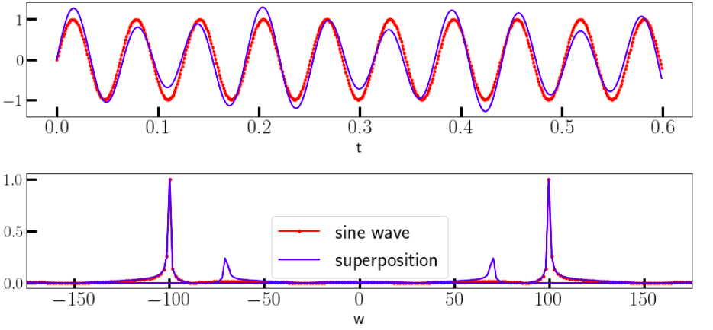
5. Exercises
import numpy as np
import matplotlib.pyplot as plt
plt.rcParams['figure.figsize'] = (12,6)
plt.rcParams['font.size'] = 20
sample_rate = 1000
Delta = 1/sample_rate
sample_size = 4000
t = np.arange(sample_size) * Delta
padded_size = 2**np.ceil(np.log2(sample_size)).astype(int)
s1 = np.sin(100*t)
s2 = s1 + 0.3 * np.sin(70*t)
sp1 = np.fft.fft(s1, n=padded_size)
sp2 = np.fft.fft(s2, n=padded_size)
freq = np.fft.fftfreq(padded_size, d=t[1]-t[0])
f, (ax1, ax2) = plt.subplots(2,1)
ax1.plot(t[0:600], s1[0:600], "r.-", label='sine wave', alpha=0.6)
ax1.plot(t[0:600], s2[0:600], "b", label='superposition')
ax1.set_xlabel('t')
ax2.plot(2*np.pi*freq, np.abs(sp1)/np.amax(np.abs(sp1)), "r.-", label='sine wave')
ax2.plot(2*np.pi*freq, np.abs(sp2)/np.amax(np.abs(sp2)), "b", label='superposition')
ax2.legend()
ax2.set_xlabel('w')
ax2.set_xlim(-175,175)
plt.show()

Slide 46
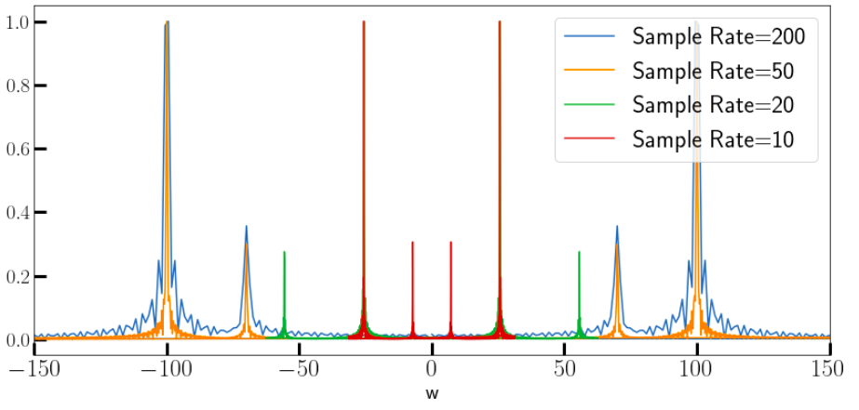
5. Exercises
1b. FFT and Aliasing:
Take the previous signal and plot the FFT for a range of sample rates
Can you see the effects of aliasing if the sample rate is too low? How low?
import numpy as np
import matplotlib.pyplot as plt
plt.rcParams['figure.figsize'] = (12,6)
plt.rcParams['font.size'] = 20
sample_rates = [200, 50, 20, 10]
sample_size = 600
for s in sample_rates:
Delta = 1/s
t = np.arange(sample_size) * Delta
padded_size = 2**np.ceil(np.log2(sample_size)).astype(int)
signal = np.sin(100*t) + 0.3 * np.sin(70*t)
ft = np.fft.fft(signal, n=padded_size)
freq = np.fft.fftfreq(padded_size, d=t[1]-t[0])
plt.plot(2*np.pi*freq, np.abs(ft)/np.amax(np.abs(ft)),\
label=f'Sample Rate = {s}')
plt.xlabel('t')
plt.legend()
plt.xlabel('w')
plt.xlim(-150,150)
plt.show()

Slide 47
5. Exercises
2. Using FFT to filter noisy signals:
Goto the GitHub repository for this course and download the following files:
    ‘fftdata/times.npy’,
    ‘fftdata/signal.npy’,
    ‘fftdata/noisy_signal.npy’
Load these files into numpy arrays
Plot the data from the signal files as a function of the data in the times file
Now, do FFTs of the signal data and plot them as functions of frequency
For now, assume that the time data is regularly spaced, otherwise you’ll have to regularize it by interpolation
Is the FFT data what you expected?
Clean up the FFT data of the noisy signal by removing the ‘noisy frequencies’ .
Visually estimate the noise threshold in the amplitudes and set all data below that to 0.
Finally, take an inverse FFT of the masked data and see if you succeeded in cleaning it up

Slide 48
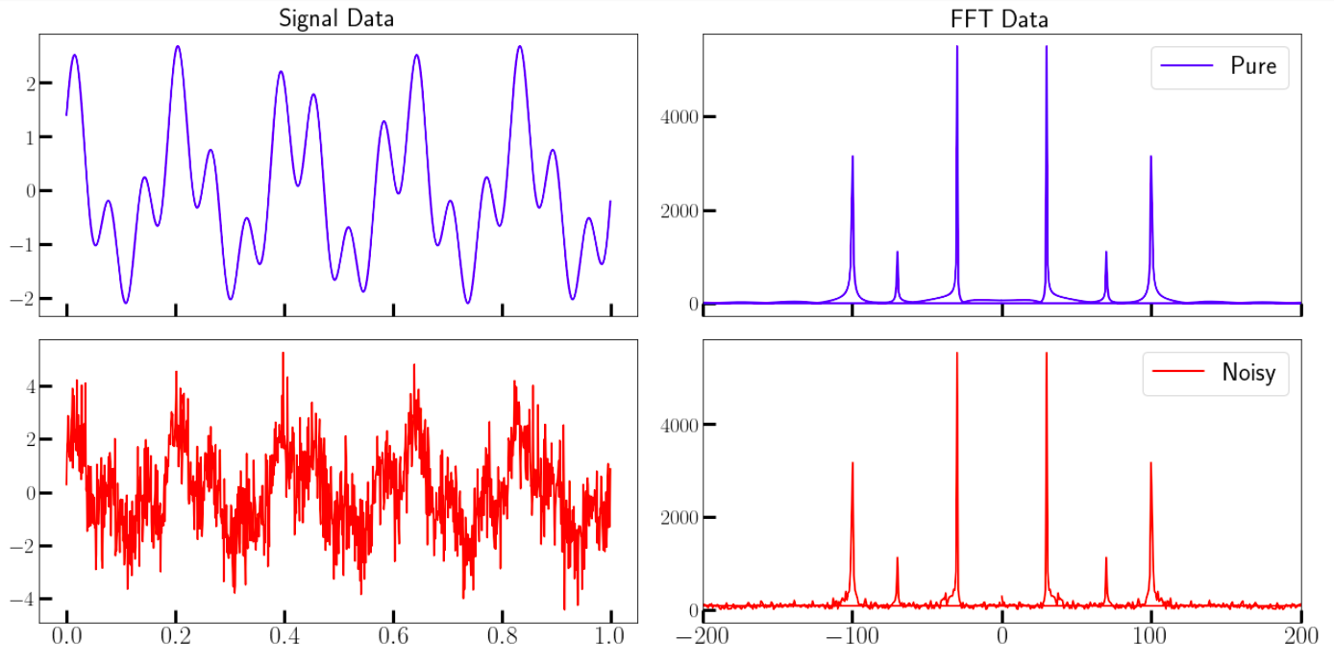
5. Exercises
import numpy as np
import matplotlib.pyplot as plt
plt.rcParams['figure.figsize'] = (18,9)
plt.rcParams['font.size'] = 20
# Load the datasets from files
times = np.load('fftdata/times.npy')
signal = np.load('fftdata/signal.npy')
noisy_signal = np.load('fftdata/noisy_signal.npy')
# Create a 2X2 grid of axes
f, axs = plt.subplots(2,2, sharex='col')
#Plot the raw datasets on the first column axes
axs[0,0].plot(times[0:1000], signal[0:1000], color="blue")
axs[0,0].set_title("Signal Data")
axs[1,0].plot(times[0:1000], noisy_signal[0:1000],color="red")
# Do the FFT of the datasets
sample_size = times.shape[-1]
padded_size = 2**np.ceil(np.log2(sample_size)).astype(int)
ft_sig = np.fft.fft(signal, n=padded_size)
ft_noisy = np.fft.fft(noisy_signal, n=padded_size)
freq = np.fft.fftfreq(padded_size, d=t[1]-t[0])
#Plot the fft datasets on the corresponding rows of the last column
axs[0,1].plot(2*np.pi*freq, np.abs(ft_sig), color='blue', label='Pure')
axs[0,1].set_title("FFT Data")
axs[1,1].plot(2*np.pi*freq, np.abs(ft_noisy), color='red', label='Noisy')
for ax in axs[:,1]:
ax.set_xlim(-200,200)
ax.legend()
plt.legend()
plt.show()

Slide 49
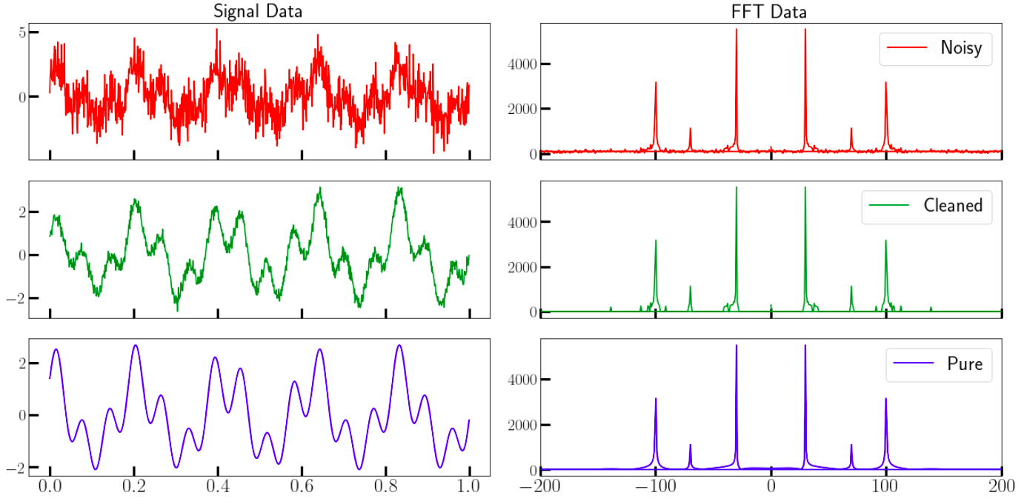
5. Exercises
import numpy as np
import matplotlib.pyplot as plt
threshold = 200
ft_abs = np.abs(ft_noisy)
indices = ft_abs > threshold # filter out those value under 300
ft_clean = indices * ft_noisy # noise frequency will be set to 0
cleaned_signal = np.fft.ifft(ft_clean) # Do inverse FFT
# Create a 2X2 grid of axes
f, axs = plt.subplots(3,2, sharex='col')
#Plot the raw datasets on the first column axes
axs[0,0].plot(times[0:1000], noisy_signal[0:1000], color='red')
axs[0,0].set_title("Signal Data")
axs[1,0].plot(times[0:1000], cleaned_signal[0:1000].real, color='green')
axs[2,0].plot(times[0:1000], signal[0:1000].real, color='blue')
#Plot the fft datasets on the corresponding rows of the last column
axs[0,1].plot(2*np.pi*freq, np.abs(ft_noisy), color='red', label='Noisy')
axs[0,1].set_title("FFT Data")
axs[1,1].plot(2*np.pi*freq, np.abs(ft_clean), color='green', label='Cleaned')
axs[2,1].plot(2*np.pi*freq, np.abs(ft_sig), color='blue', label='Pure')
for ax in axs[:,1]:
ax.set_xlim(-200,200)
ax.legend()
plt.show()
Homework: Use a similar technique to separate the two frequencies in the cleaned data and plot them
Independently.

Slide 50
5. Exercises
3. Compare FFT speed with DFT speed on random arrays of varying sizes.
Write (or find) a Python routine that:
  Takes a numpy array f as its argument.
  Evaluates the DFT vector F using the formula given on the right.
  Evaluates the execution time.
  Returns both of the above.
Generate random column vectors of sizes 16, 32, 64, 128, 256, 512, 1024, 2048, and 4096.
Run the above subroutine and plot the execution time
as a function of data size. Interpret the curve.
Repeat the steps above with the builtin FFT routine.
In both cases, plot the execution time as a function of size and compare, then:
  Plot the execution time for the DFT case as a function of size^2
  Plot the execution time for the FFT case as a function of size*log2(size)
  What can you infer from these graphs?

Slide 51
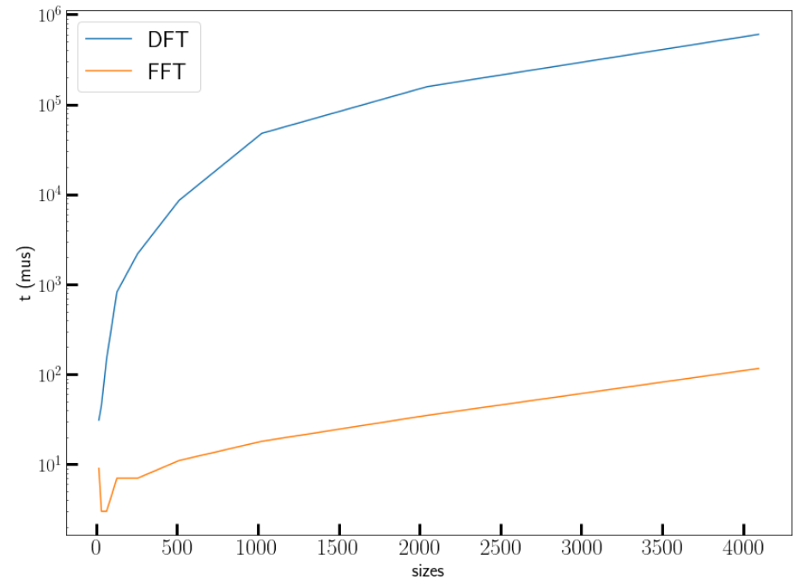
5. Exercises
import numpy as np
def dft(x):
"""
Function to calculate the
discrete Fourier Transform
of a 1D real-valued signal x
"""
N = x.shape[-1]
n = np.arange(N)
k = n.reshape((N, 1))
e = np.exp(-2j * np.pi * k * n / N)
return e @ x
x = np.random.random(100)
print(np.allclose(dft(x), np.fft.fft(x)))
import matplotlib.pyplot as plt
plt.rcParams['figure.figsize'] = (8,6)
plt.rcParams['font.size'] = 20
from timeit import Timer
defnum = 20
mysetup = 'import numpy as np\n'
mysetup += '''def dft(x):
N = x.shape[-1]
n = np.arange(N)
k = n.reshape((N, 1))
e = np.exp(-2j * np.pi * k * n / N)
return e @ x'''
sizes = 2**np.arange(4,13)
times_dft = np.zeros_like(sizes)
times_fft = np.zeros_like(sizes)
for i,s in enumerate(sizes):
dft = Timer(setup=mysetup, stmt="dft(np.random.random(%d))" % (s,))
times_dft[i] = min(dft.repeat(number=defnum)) * 1e6 / defnum
fft = Timer(setup=mysetup, stmt="np.fft.fft(np.random.random(%d))" % (s,))
times_fft[i] = min(fft.repeat(number=defnum)) * 1e6 / defnum
plt.plot(sizes, times_dft,label="DFT")
plt.plot(sizes, times_fft, label="FFT")
plt.xlabel("sizes")
plt.ylabel("t (mus)")
plt.yscale('log')
plt.legend()
plt.show()

Slide 52
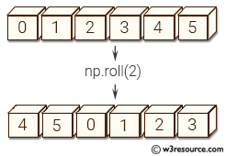
5. Exercises
4. Convolutions via FFT
Generate two vectors ‘f’ and ‘g’ of equal size (choose a large size, preferably a power of 2), consisting of random numbers, and evaluate the convolution vector , where the elements of c are given by
  Imagine that the elements of ‘f’ lie on a ring. Then, the l^{th} component of ‘c
  involves the components of ‘f’ after ‘rolling’ this ring by l places.
  In numpy, there is a function ‘numpy.roll’ that does this. Use that function.
Now, get the FFTs of the two vectors, compute their element-wise product, and do the IFFT of the result. Sum over this.
Is this sum equal to the first result? Why?
  Repeat for a few different sets of two random vectors.
  Recall the convolution theorem
If they are indeed equal as expected, then which method is faster and why?
  Use the %timeit magic in Jupyter to measure runtimes

Slide 53
5. Exercises
4. Convolutions via FFT
import numpy as np
N = 2**15
f = np.random.random(N)
g = np.random.random(N)
print("Normal Convolution:")
%timeit c = np.array([np.sum(np.roll(f,-l-1)[::-1]*g) for l in range(N)])
c = np.array([np.sum(np.roll(f,-l-1)[::-1]*g) for l in range(N)])
print("\nConvolution by FFT:")
%timeit c_fft = np.fft.ifft(np.fft.fft(f) * np.fft.fft(g))
c_fft = np.fft.ifft(np.fft.fft(f) * np.fft.fft(g))
print("\nAre they equal?", np.allclose(c, c_fft))
Normal Convolution:
1.91 s ± 10.7 ms per loop (mean ± std. dev. of 7 runs, 1 loop each)
Convolution by FFT:
1.4 ms ± 23.7 µs per loop (mean ± std. dev. of 7 runs, 1000 loops each)
Are they equal? True

